Slide 1
INTRODUCTION TO OBJECT ORIENTED PROGRAMMING

Slide 2
Classification of Programming Languages
Classification
Pgm languages
Un structured
Un broken codes
Having n number of Go to statements
Ex: Cobol , Basic , Fortran , Mdos Batch Files
Structured
Smaller code functions
For each operation can maintain structured
Ex: Pascal , Ada , C
Object Oriented
Always oriented on Objects
JAVA

Slide 3
History
James gosling , patrick naughton
Group of programmers developed STEALTH project (before creation of java)
(JAVA named – Coffee shop)
Generation
Stealth ( need graphical moved to next level) –
C++ (future enhancement) – 1990 OAK
1991 - JAVA

Slide 4
JAVA EDITIONS
J2SE – Standard edition (core Java)
J2EE- Enterprise Edition ( All process kept in to a common place – Netbeans (IDE))
J2ME – JAVA Mobile Edition
(Embedded System)

Slide 5
Java Features
Familiar ( Netscape makes familiar about java)
Simple ( no pointers)
Robust & secure ( Exceptional Handling and Garbage collection)
Platform Independent
C,C++ - compiled – exe file – byte code will not match for different OS
Java – Compiled file – (byte code instruction) (assembly language readable by human and system ) – byte code match for any OS

Slide 6
JVM (Java Virtual Machines)
JAVA Runtime Environment
Method Area (all methods in the class loaded in that area)
Heap Memory ( Objects use the Heap memory Stu obj= new stu())
Java Stack (At the time of execution variables , methods copy will be there)
PC register ( number of variables , methods maintained there)
Native method ( link with various languages c , C++ informations)

Slide 7
Executable Engine
To execute the Class File of JAVA
Execution:
Java Class Name

Slide 8
Classes & Objects
Objects : What are all the things physically existed is called objects
Class : What are all the things not physically existed in the world is called class.
Sun Flower
Rose Flower
Jasmine Flower
Lily Flower

Slide 9
First pure object oriented language is SIMULA.
Java is not 100 percent object oriented because we are accessing information from c and c++.
Procedure Oriented | Object Oriented
Importance given to
Sequence of Code | Given to DATA
Larger program divided into
Smaller program functions | Objects
Top down approach | Bottom up Approach
PASCAL , C , etc.. | Small talk , JAVA, C# , C++

Slide 10
Features OF OOPs
Class/ Object
Encapsulation
Abstraction
Inheritance
Polymorphism

Slide 11
Abstraction
Showing the important data.
Ex. Car (showing the important parts (door, seat,etc..)
Ex: customer – Banking
Watchman (security) – Basic details of customer
Clerk- Manipulation of Data
Manager - Personal details of the customer
Level of showing information may vary but it will be important according to the Post

Slide 12
Encapsulation :
Hiding the important things is called Encapsulation.
Polymorphism
Multiple Personality (Many Forms )
A single object can mean in different way
A word “ See u Later “ will depict two different way of meaning to the Person.: To the FRIEND & ENEMY

Slide 13
Main declaration
Public static Void Main(String args[])
Public: Public is a keyword of the access specifier. Class declared as a public, it can access anywhere using extends keyword. The main method declared as public, so that we can access the member out of the class.
Static: Static is creating an instance of a function automatically. The keyword allows to access the main() method which is called without having the instantiate a particular instance of the class. The java interpreter first call the main() method without creating any objects(instance) by using static keyword.
Void: void is empty data type, its does not return any values. Because methods may return any values. Main method does not return anything so the return type must be void.
Main(): It is the Main method. Method called when java interpreter begins. (main method should be main not Main because java is case sensitive)

Slide 14
Difference Between Import and Include
Import – have separate folder for execution of LIB files
Include – will include the lib files in the existing program will make much Space for Storage and for execution

Slide 15
Java Data types
Default constructor
Primitive ( normal Data Types)
Reference Types:
Stu s = new Stu();
Object allocation new space
Reference

Slide 16
Methods – defined inside the class
Function – Defined outside the class
Person p = new person();
Person p1= new person();
// here we can able to differentiate the allocation of the same class using HASH CODE
s.op (p1.hashcode() );
s.op (p.hashcode() );

Slide 17
Type of Methods
Instance Method – depends on Object
Static method – can invoke only static data member
Factory method – Formatting of data

Slide 18
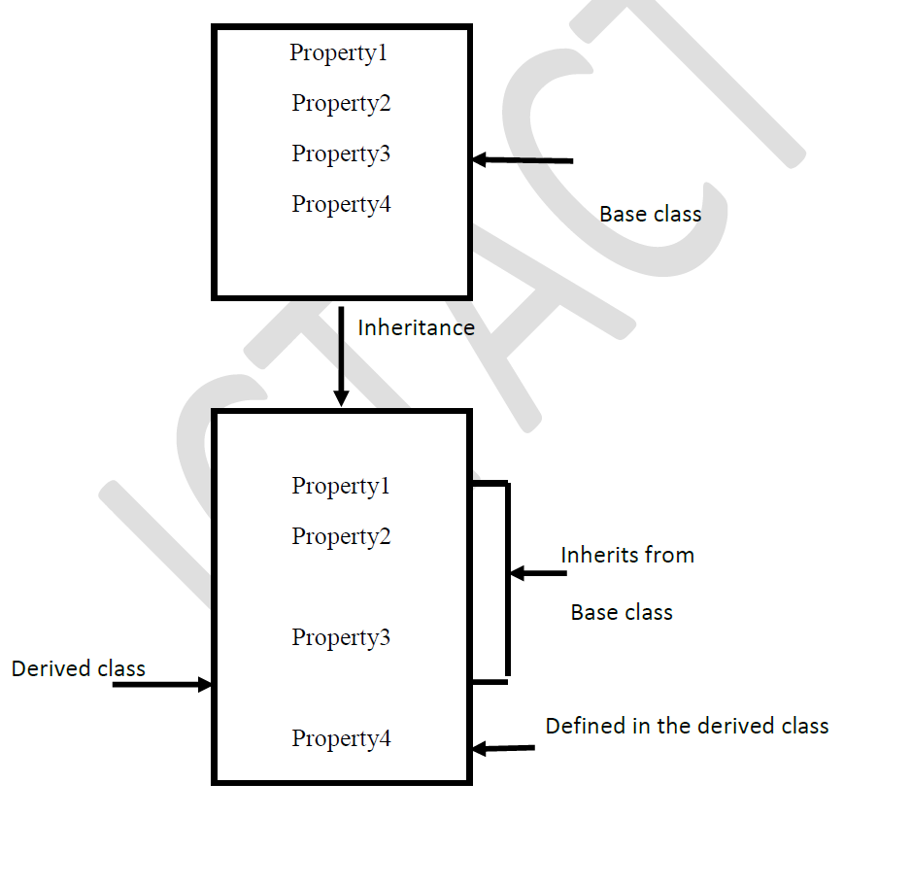
Inheritance

Slide 19
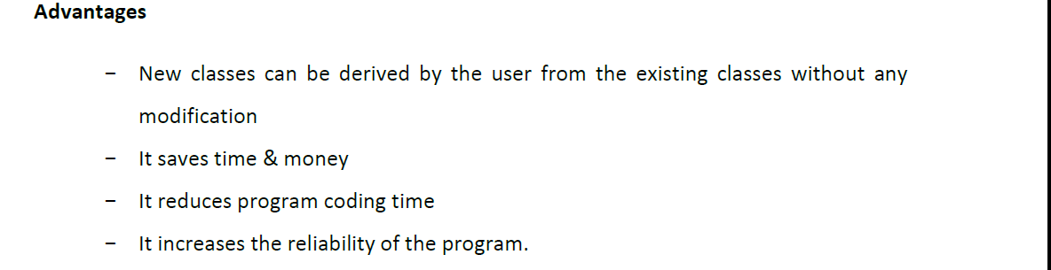

Slide 20
Abstract Classes
Contain Abstract Classes
Concrete Methods
Idea for all the Classes is called an Abstract Class

Slide 21
// Abstract Method and Classes
abstract class Ebill
{
double rate;
abstract void getrate();
public void calcultateBill(double units)
{
System.out.println("Current charge " +(units *rate ));
}
}

Slide 22
class Domesticplan extends Ebill{
void getrate()
{
rate=6.0;
}
}
class commercialplan extends Ebill{
void getrate()
{
rate=10.0;
}
}

Slide 23
public class AbstractDemo {
public static void main(String[] args) {
Ebill eb1; // Abstract class reference
eb1=new Domesticplan(); // accessing the derived class using the abstract class object
eb1.getrate();
eb1.calcultateBill(2);
Ebill eb2;
eb2=new commercialplan();
eb2.getrate();
eb2.calcultateBill(20);
}
}

Slide 24
Interface
In interface all methods should be implemented
Which functions particularly used in classes can put in interface
Example:
Interface DB
{ void connect();
void disconnect();
}

Slide 25
Multiple inheritance - Interface
Indirectly we can achieve Multiple inheritance using interface..
Class B implement A, C
While using
- interface ( JVM look for A and the C)
- extends ( JVM will confuse to choose whether A or C)

